Slide 1
Introduction to CompUTER architecture
IT 301
Notes:
As software developers, we tend to think at a much higher level than the physical activities that occur on our computers as a result of the code we write. In this topic, we're going to take a look "under the hood" of the computer. The goal in doing so is to become more aware of how our choices as software developers impact the way the computer runs.

Slide 2
Topics
What Makes a Computer a Computer?
What is Computer Architecture?
What is a Instruction Set Architecture?
The von Neumann Model
Machine Instructions and Data Values
Fetch Decode Execute Store Cycle
Notes:
Neumann – defines organization at a high level
instructions/data – basis of architecture
CPU components – define what happens in the CPU
how instructions are executed
closer look at how instructions are composed

Slide 3
What Makes a Computer a Computer?
Input
Storage
Processing
Output
Click for Introductory Video: How Computers Work: What Make a Computer, a Computer
Notes:
What do we mean by the term "computer architecture"?

Slide 4
What is Computer Architecture?
May refer to all the hardware of the computer .
In this unit, we will focus on the computer’s processor architecture (CPU)
A particular processor implements a specific Instruction Set Architecture (ISA)

Slide 5
What is an Instruction Set Architecture (ISA)?
ISA is a set of instructions and their binary encoding (opcodes)
A set of CPU (Central Processing Unit) registers
Describes the effects of executing instructions on the state of the processor
A particular processor implements a specific Instruction Set Architecture (ISA)

Slide 6
Well Known Instruction Set Architectures
SPARC (RISC)
Intel Architecture, 32 bit (IA32)
Intel implements
AMD implements
Intel Architecture, 64 bit (IA64)
MIPS (used in zyBooks - RISC)

Slide 7
Instruction Set Architecture Word Size
ISA’s are governed by the size of instructions and data elements they support
32-bit
64-bit (common today)
The bit-size of the ISA determines:
the number of bits that a processor can handle as a single unit
the number of addressable memory locations
32 bits ~4.3 billion-4,300,000,000
64-bit ~9.2 quintillion-9,200,000,000,000,000,000
Notes:
The size and format of a computer's instructions are central to the definition of a computer's architecture.
You've no doubt heard of 32-bit and 64-bit machines. These numbers define the size of a memory location in memory.
Consider, in memory, the smallest piece of information we can track is a single bit – on/off… at the hardware level, it is simply the presence of electricity or not. But one bit isn't large enough to store useful information. So we combine bits together. We know that 8 bits make a byte. In MIPS*, bytes are individually addressed but even a byte won't store much information – you can only store 256 pieces of information. So again, we combine more into units that are larger so that we can store meaningful information in them. The number of bits we combine into a unit that is processed as one memory unit is called a word. A word defines the architecture.
dictates the number of possible memory addresses
the largest data value that can be stored
so for 32-bit architecture, ~4.3 billion
64-bit: ~9.2 quintillion
*MIPS is a RISC architecture that used to be used in workstations and servers in the 80's but is still used today for educational purposes as it is easily to understand than other instruction sets

Slide 8
The von Neumann model
The architecture of modern computers
Notes:
The von Neumann model defines the architecture of modern-day computers. Let's take a look at it.

Slide 9
Neumann model – Big Picture
Hardware Logical View
Bus
Processor (CPU)
Memory
Input-Output
Control Unit
Processing Unit
Communicates with
“outside world”, eg.
Screen
Keyboard
Storage (Disks, Flash Drive…)
Network
Stores data and
programs
Executes program
Performs arithmetic
or logical operations
Notes:
This is a logical view. Physical layout of these components do not look like this.

Slide 10
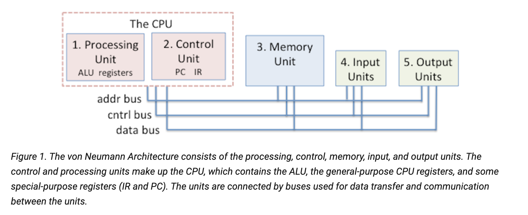
Neumann model – More Detail
Dive Into Systems: Chapter 5

Slide 11
CPU – Control Processing Unit
CPU is made of two units: Processing and Control
CPU executes Program Instructions on Program Data
Processor (CPU)
Processing Unit
Arithmetic Logic Unit Registers
(ALU)
Control Unit
PC IR
Notes:
The Control Unit drives the execution of program instructions by loading them from memory and feeding instruction operands and operations through the processing unit. The control unit also includes some storage to keep track of execution state and to determine its next action to take: the Program Counter (PC) keeps the memory address of the next instruction to execute; and the Instruction Register (IR) stores the instruction that is currently being executed.

Slide 12
ALU – Part of Processing Unit
Performs all arithmetic and logic on a CPU
Typical instructions:
Logical
AND OR XOR NOT
NAND NOR
Arithmetic
ADD SUB MULT DIV
Other
Bitwise shifting
Comparisons
Arithmetic Logic Unit
(ALU)
Notes:
Recognize the boolean operations? These are hardware operations – that is, created in digital circuitry (transistors)
NAND – not AND. Look at truth table for & and reverse the final column
NOR – not OR. Again look at truth table for | and reverse the final column.

Slide 13
Memory
There are different levels of memory
CPU Registers
Cache memory. (Close to CPU)
Primary Memory (RAM)
Secondary Memory (Disk)
Memory
Notes:
Two types of memory: volatile (loses data if power cut) and non-volatile (doesn't lose data when no power).
Registers, cache, and main/primary memory(RAM) is volatile. Secondary (Disk Drives) is non-volatile.

Slide 14
Instructions and Data Exist Together in von Neumann
Notes:
So with Von Neumann, instructions (program) and data exist toether in memory. Let's look at how that works.

Slide 15
The von Neumann Model
Memory Addresses
0 … 000000 0 … 000001 0 … 000010 0 … 000011 0 … 000100 0 … 000101 0 … 000110 0 … 000111 0 … 001110 1 … 111111
…
Data value
Machine instruction
Memory
Notes:
In the Von Neumann model, both instructions and data can be stored in primary memory (RAM)

Slide 16
A computer “word”
Memory Addresses
0 … 000000 0 … 000001 0 … 000010 0 … 000011 0 … 000100 0 … 000101 0 … 000110 0 … 000111 0 … 001110 1 … 111111
…
Word: a unit of memory
32-bits or 2³² (4,294,967,296)
possible numeric
values
Memory
Notes:
At each memory address, is a word: fixed-sized grouping of contiguous bits that are treated as a single unit by the processor
If we think of memory as a column of locations, we can address from all 0 bits to all 1 bits for as many bits are in a word…
In memory addressing schemes we do not use a bit to represent the sign so we can use all the bits to access memory locations
2^10 = KB (~ 1000 bytes) 1024 B
2^20 = MB (~million) 1024 KB
2^30 = GB (~billion) 1024 MB
2^40 = TB (~trillion) 1024 GB

Slide 17
Instruction sets
RISC Reduced Instruction Set Computing
CISC Complex Instruction Set Computing
Has simpler instructions
Requires less hardware complexity required to execute instructions
Emphasis on software
Has complex instructions
Requires less instructions to accomplish a task
Requires more hardware complexity to handle instructions
Emphasis on hardware
Notes:
RISC – reduced number of instructions, so takes more instructions to complete an operation. But less hardware to build circuitry to perform an instruction.
MIPS is example
CISC – Single instruction can perform more complex tasks – would take multiple instructions to complete same task in RISC instruction set.
Intel 8080 is example

Slide 18
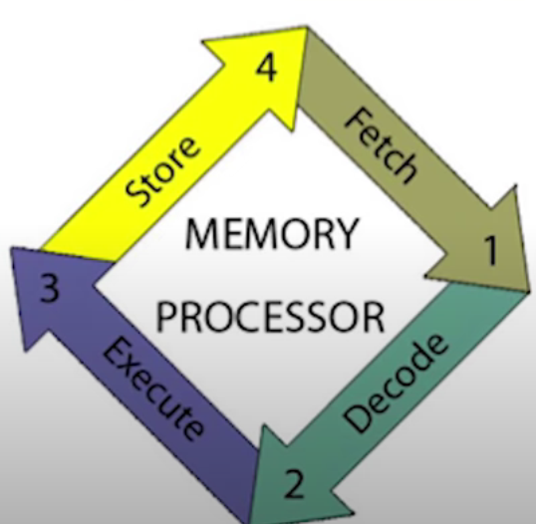
Fetch Decode Execute Store Machine Cycle
Notes:
We write programs that we want to execute. Our programs have to become instructions on the machine, then be executed. What really happens when we run a program?

Slide 19
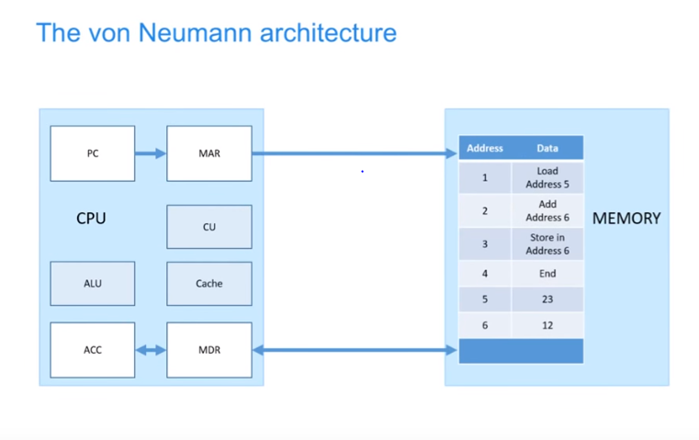
Modeling the Machine Cycle with von Neumann architecture
Click here for a video demo of the Machine Cycle
OCR GCSE 1.1 The von Neumann architecture
Notes:
CU – Controlling UNIT – sends signals to control how data moves around the CPU
Cache – provides fast access to most used instructions and data
ALU-Arithmetic Logic Unit performs calculations and logical decisions
Some Registers:
MAR – Memory Address Register holds the address of where data is to be fetched or stored
MDR – Memory Data Register holds the data fetched from or to be written to the memory
PC – Program Counter Register – holds the address of the next instructions in memory
ACC – Accumulator Register holds the results of calculations

Slide 20
Fetch, Decode, Execute, Store Cycle
Each instruction executed on a CPU goes through four steps, managed by the control unit
Fetch: get the next instruction from memory and place in IR(Instruction Register) and increment PC(Program Counter)
Decode: which operations to perform and retrieve the operands
Arithmetic?
Add or subtract?
Load data from address
Execute: ALU performs the instruction operation on instruction data operands
Store: store the result to memory
Notes:
Each instruction is processed in four basic steps…
we all use the four operations of the machine cycle every day. For example, when placing an order in a fast-food restaurant we fetch (read the menu), decode (translate the menu into an order), execute (place the order), and store (take our food to the car).

Slide 21

The PC register
Called the program counter
A register that holds the address of the next instruction to execute
Not the instruction itself!
Notes:
In the Fetch step – how does the computer know what instruction to look for?
Uses the program counter
Holds an address of the next instruction – not the actual instruction

Slide 22
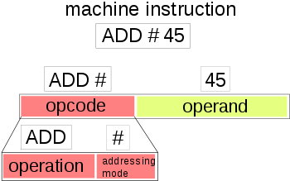
The IR register
Called the instruction register
A register that stores the instruction received from memory
Stores the instruction itself!
This Photo by Unknown Author is licensed under CC BY-SA

Slide 23
Fetch, Decode, Execute, Store Cycle
Program Counter
Memory Addresses
0 … 000000 0 … 000001 0 … 000010 0 … 000011 0 … 000100 0 … 000101 0 … 000110 0 … 000111 0 … 001110 1 … 111111
…
0 … 000101
2. fetch instruction
(PC then incremented by 1 address)
get PC
3. decode
Processor (CPU)
Control Unit
IR
4. execute
Arithmetic Logic Unit
(ALU)
5. store
Memory
Notes:
To process a single instruction:
CPU looks at the PC to determine where to find the next instruction
fetches the instruction from memory places in IR and at the same time, increments the PC to point to the next instruction.
CPU decodes the meaning of the instruction and if a calculation is needed, sends it off to the ALU to do the execution
Control unit then stores result in memory

Slide 24
The big picture
Computers are instruction execution engines that endlessly run a fetch-execute cycle:
PC
…
Processor (CPU)
1. fetch
Control Unit
2. decode
Memory
3. coordinate
4. retrieve operands
Arithmetic Logic Unit
(ALU)
5. execute
6. store result
Registers
Notes:
Computers are just fetch-execute engines, repeating the preceding process over and over again.
ALU processes all arithmetic and logical operations – performing max of one operation at a time
Here's a look at the cycle.
data is pulled from memory into registers
data is not cleared from registers by default
may be overwritten by subsequent instruction processing
compilers try to store frequently used variables in certain registers so the time needed to pull the data from memory can be cut out
when register space is needed, compilers try to move less-used variables out of registers (called "spilling" registers)

Slide 25
zyBooks Programmable Processor Concepts
You will practice working with pieces of this Fetch, Decode, Execute and Store Machine Cycle when you work through the zyBooks Programmable Processor assignment on canvas

